Slide 1

VIGNAN’S INSTITUTE OF INFORMATION TECHNOLOGY (A):: DUVVADA,VISAKHAPATNAM
Department of Computer Science and Engineering
2018-2022 Batch B.Tech Mini Project
Project Title
Diagnosis of Disease (Heart diagnosis site)
CSE-2 :: Batch No : B-15
Guided by DR G.RAJENDRA Kumar
NAME | Register Number | ROLE
M.A SHANAWAZ | 18L31A05E0 | Team Lead
P.HANISHA | 18L31A05H0 | Team Member
K.K MAHEEDHAR | 18L31A05F3 | Team Member
G.PAVAN KUMAR | 18L31A05D6 | Team Member

Slide 2
Abstract of Heart Diagnosis Site (HDS).
Heart diagnosis site is used to predict whether your heart may have heart disease or not.
heart attacks may feel uncomfortable squeezing, pressure, fullness, or pain in the center of the chest. It may also cause pain in one or both arms, the back, neck, jaw or stomach, shortness of breath, nausea and other symptoms. Men experience typical symptoms of heart attack, such as chest pain , discomfort, and stress. They may also experience pain in other areas, such as arms, neck , back, and jaw, and shortness of breath, sweating, and discomfort that mimics heartburn.
Chest burnings and little pains are part of the daily life, we cannot predict the stability of the heart until the severe stage, ignorance and irregularity we definitely affect your heart.

Slide 3
But by using artificial intelligence we made this work a little bit easier, we can predict the likely outcomes of one may have heart disease by using some simple features.
By embedding our HDS classification model with a web application, every one can use this with ease and the data which is used to train the model is very large, so the accurancy will be more.
By using certain features of a particular disease we can classify the severity of the particular disease, by using some classification algorithms like Logistic Regression, Naïve Bayes, Stochastic Gradient Descent, K-Nearest Neighbours, Decision Tree, Random Forest, Support Vector Machine, Neural Networks. by creating an efficient algorithm we can classify the aid or precautions required for the current stage of the disease affected.
We also provide an interactive UI for the users to use and enter the features of the disease they want to know so that they can be aware and decide the next step, as this application can be used in an emergency. so we will use the best framework and optimal algorithms to speed up the execution time.

Slide 4
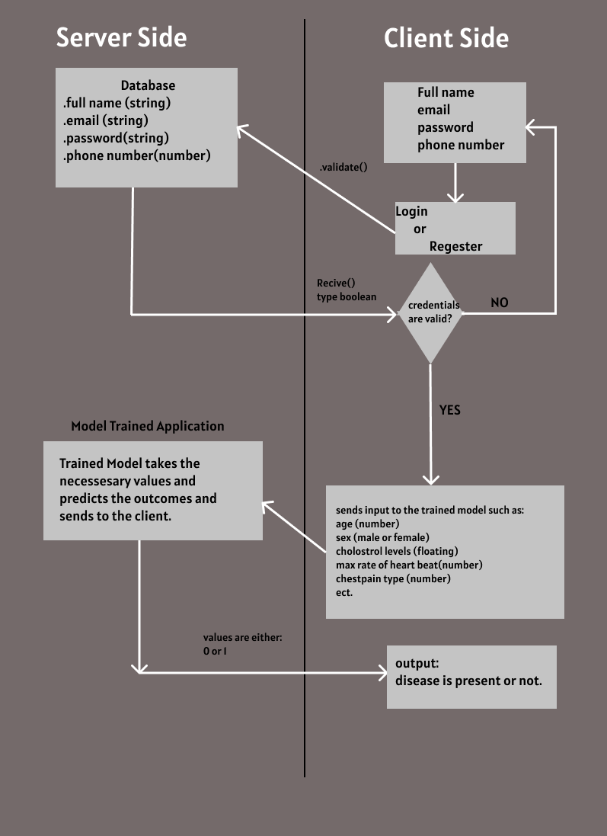
OOP Diagram for our HDS

Slide 5
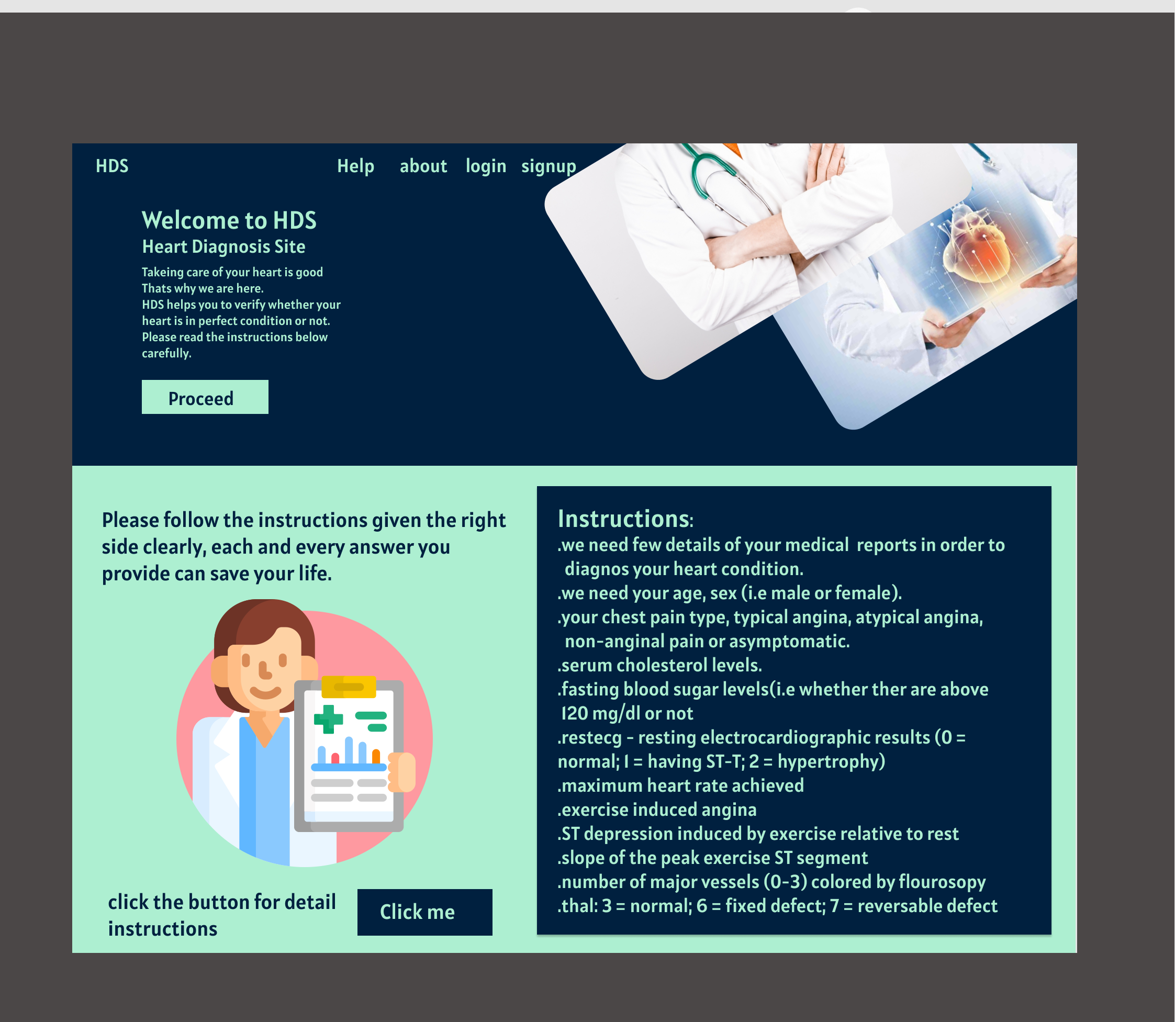
Sample Preview of our HDS Heart Diagnosis Site

Slide 6







Techonology Stacks
Angular
Python
HTML
GO Lang
Type Script

Slide 7
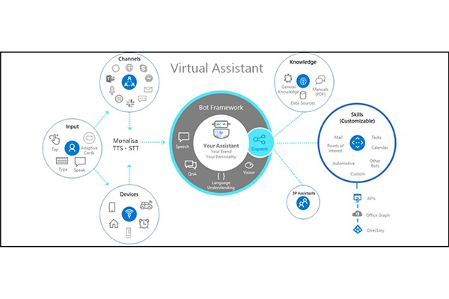
System Requirments
Client Side:
Any android or Ios os
Windows 7+ versions
Internet browser which supports HTML 5
Ram: atleast 500mb
Server Side:
Databases which support sql or noSql servers
Systems must contain atleast 500gb storage,
Ram: atleast 4gb,
GPU optional

Slide 8
Thank You. Stay Safe, Stay Healthy

